Slide 1




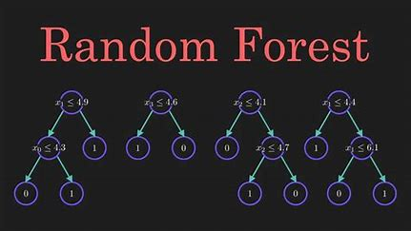
RANDOM FORESTS
Presented by:
Abdsslem Iheb
Khelifi Rafik

Slide 2
OVERVIEW
Decision Trees
Random Forests
Algorithm
Advantages & Limitations
Our Work

Slide 3
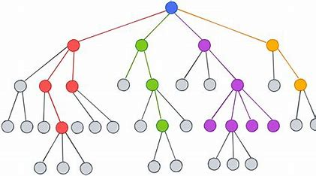
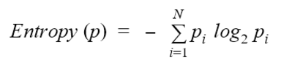
DECISION TREES
A Decision Tree is a supervised machine learning algorithm used for classification and regression tasks. It splits data into subsets to maximize the purity of the Leaves respectfully minimize the impurity (Entropy).

Slide 4
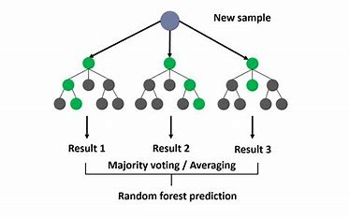
RANDOM FORESTS
Random Forest is a ensemble learning method that combines multiple decision trees to make predictions used for classification and regression purposes.

Slide 5
RANDOM FORESTS
Algorithm:
Bootstrap Sampling: Randomly select subsets of data to train each decision tree (bagging).
Feature Selection: Randomly choose a subset of features for splitting at each node.
Aggregation: Combine predictions from all trees (majority vote for classification, average for regression).

Slide 6
STRENGTHS AND WEAKNESSES
Strengths:
High accuracy.
Handles large datasets efficiently.
Works well with non-linear data.
Weaknesses:
Can be computationally expensive with many trees.
Less interpretable than a single decision tree.

Slide 7
APPLICATION OF RANDOM FORESTS
Healthcare: Disease diagnosis
Finance: Fraud detection.
Marketing: Customer segmentation.
Environment: Predicting weather patterns.

Slide 8
OUR WORK
Title: Income Classification Using Random Forests
Goal: Classify individuals' income as below or above a threshold ($50K/year).
Dataset: Contains 32k observations and 14 Feature variables
Steps Covered: EDA, feature selection, model training, hyperparameter tuning, evaluation.

Slide 9
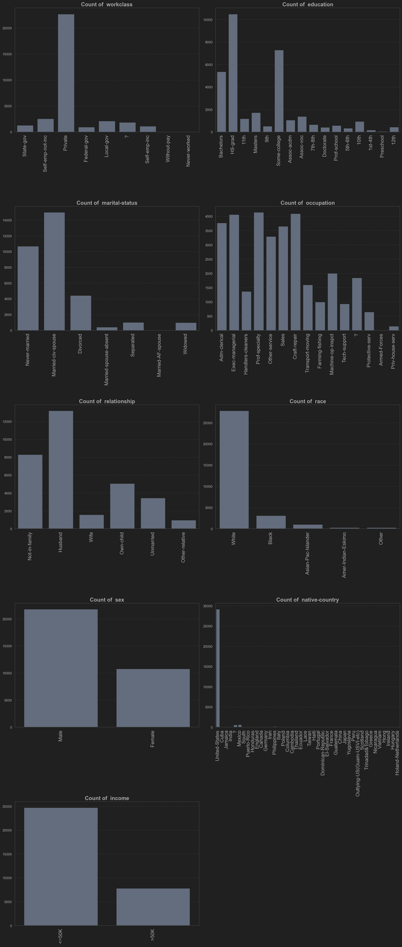
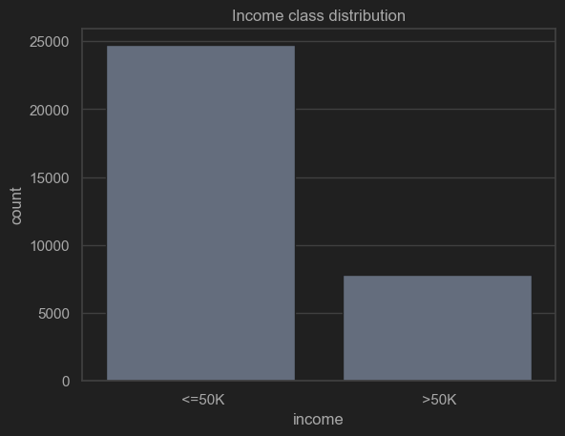
OUR WORK
EDA : Understand the data and identify key patterns such:
number of observations
Missing values
Target variable distribution
Variability of features
Feature Correlation

Slide 10
OUR WORK
Data Preprocessing :
Handling missing values
Encoding categorical variables
Feature scaling: standardization
Train-test split: split ratio 80-20.

Slide 11
OUR WORK
Feature Selection: Reduce dimensionality and improve model performance.
Recursive feature elimination
Feature importance
outcome: from 14 features to 8 features ('age', 'fnlwgt', 'education-num', 'marital-status', 'occupation', 'relationship', 'capital-gain', 'hours-per-week)

Slide 12
OUR WORK
Hyperparameter Tuning: Optimize Random Forest for better performance.
Parameters Tuned: n_estimators, max_depth, min_samples_split, min_samples_leaf, etc.
Method: Random Search with Cross-Validation.
Conclusion : improve by a 2%

Slide 13
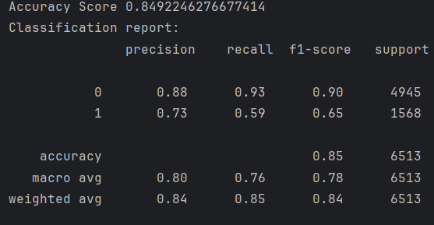
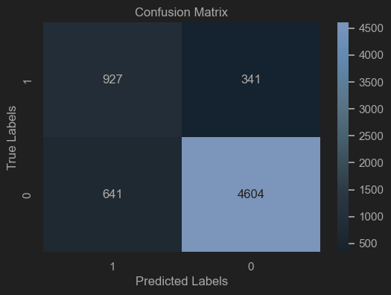
MODEL TRAINING AND EVALUATION
Metrics Used:
Accuracy, Precision, Recall, F1-Score
Results:
F1-SCORE : 0.85
Interpretation:
Low Recall indicates incorrectly identifying True positives caused by the Imbalanced dataset.
Gathering more data can help
Experimenting with more sophisticated ML algorithms

Slide 14
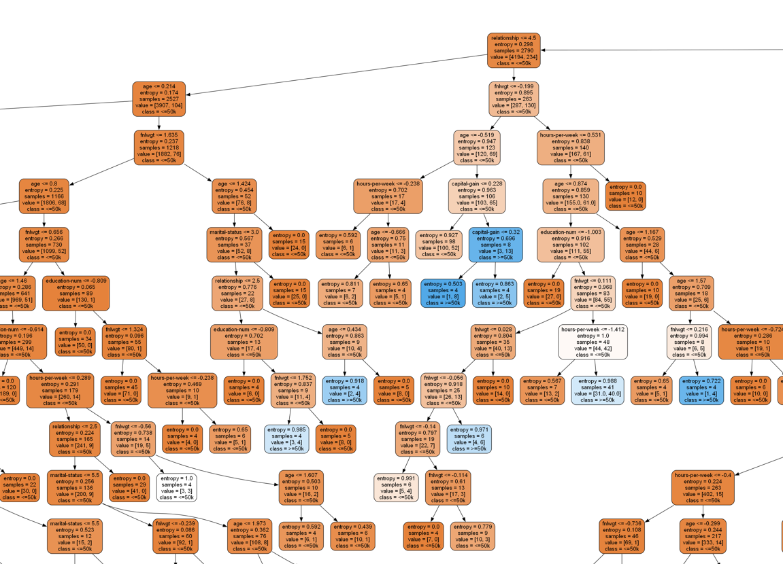

Slide 15
THANK YOU
FOR YOUR ATTENTION

